Slide 1
A Big Step into the Space
By Nikol Khoang, 11
School №14

Slide 2
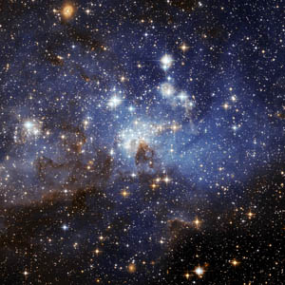
I like to watch the stars in the evening. Their beauty immediately impresses me. The sky is dark and mysterious with its bright stars and the streaming Milky Way. The stars seem so bright and close that you want to reach out and touch them.

Slide 3
Many years ago people knew nothing about stars and planets. Mankind always dreamed of overcoming gravitation and reaching other planets. But it was only in the 1960ies that this dream became reality.

Slide 4
On the 12th of April 1961 the spaceship "Vostok" was launched into space with a man on board and after orbiting our planet successfully returned to the Earth. The first man to overcome gravitation and orbit the Earth was Yuri Gagarin. This day went down in history of mankind as an outstanding achievement, opening the space era.

Slide 5
In the course of space exploration there have been lots of achievements of world science and technology. This period saw the launching of many earth satellites, numerous space laboratories. Among the achievements we may enumerate the landing of automatic stations on the Moon, the flights of space laboratories towards the Venus and Mars.

Slide 6
Now I look at the sky again and I am proud of the fact that a rocket undertaking the first flight into space departed from my country.

Slide 7
Thank you!

Slide 8
Список использованных ресурсов:
http://www.liveinternet.ru/users/michel1102/post100823227/
http://fotoku.org.ua/2010/04/06/solnechnaya-sistema-dva-kollazha/
http://www.inquisitr.com/112948/yuri-gagarin-monument-mumbai-india/
http://www.inosmi.ru/world/20090720/250843.html
Рогова Г.В., Ф.М. Рожкова. English in two years. – М.: Просвещение, 1996.

