Slide 1
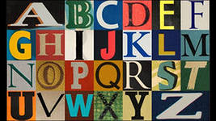
EnglishAlphabet ЗоринаСветлана по материалам Thomson Heinle, Jennifer Heath

Slide 2
A a
Red apples, green apples.
On the apple tree.
Two apples, three apples,
Lots for you and me.

Slide 3
B b
A big ball, a blue ball,
A big ball – look,
Bill likes the blue ball,
In his book.

Slide 4
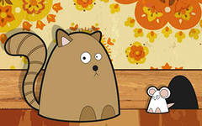
C c
Look at the cat sitting on the mat.
Look at the rat sitting in the hat.
The cat on the mat tries to catch the rat!
Oh no! Look at that! The cat is too fat!

Slide 5
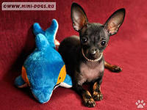
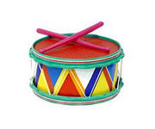
D d
Dogs dig and dig.
Dolphins dive and dive.
I play the drum.
One, two, three, four, five.

Slide 6
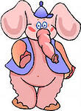
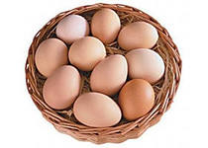
E e
Eddie the elephant has eggs every day.
Notes:
Скороговорка произносится в быстром темпе.

Slide 7
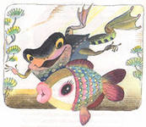
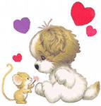
F f
In my garden, at my house,
I feed my fish and my pet mouse.
I also feed my big fat dog,
And then I feed my funny frog.

Slide 8
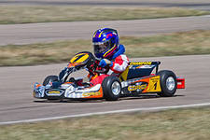
G g
Gary`s got a go-cart in the garage!
Go, Gary, go! Go, Gary, go!
Gary`s got a go-cart in the garage
Go, Gary, go! Go, Gary, go!

Slide 9
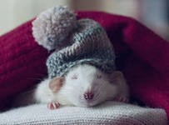
H h
Happy Henry Hamster`s got a hat on his head.
He`s got a new house, and he`s got a new bed.
Happy Henry Hamster is as happy as can be.
He loughs all day, hee hee heee hee!
He loughs all day, hee hee heee hee!
Happy Henry Hamster is as happy as can be.

Slide 10
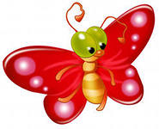
I i
Ingrid is an insect,
And she is always cold.
She lives in an igloo,
At the North Pole.

Slide 11
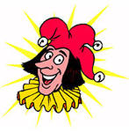
J j
Johnny`s a jester. He comes from France.
He loves to sing and jump and dance.
H makes the children laugh and laugh.
He`s a jolly jester with a long red scarf!
Oh Jonny, jolly Jonny!
Jonny makes the children laugh.
Oh Jonny, jolly Jonny!
He`s a jolly jester with a long red scarf!

Slide 12
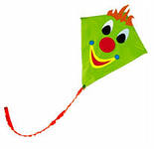
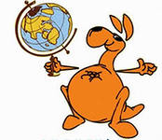
K k
Kylie the kangaroo likes the king`s kite!

Slide 13
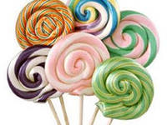
L l
Ten lovely lollipops in a jar.
Lovely lollipops to lock in the car.
One lovely lollipop in my tummy!
Nine lovely lollipops!
Yummy! Yummy! Yummy!

Slide 14
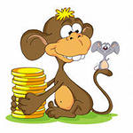
M m
Monday morning in the month of May,
I fly to the moon and to the Milky Way.
Mike the monkey and Mary the mouse,
Stay at home to clean the house.

Slide 15
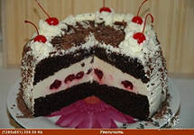
N n
“Blow your nose!’ said Uncle Nick.
“No, no, no!” said Faye.
“Naughty girl!” said Uncle Nick,
“No cake for you today!”

Slide 16
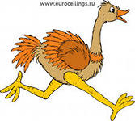
O o
Olly the Octopus. Olly the Octopus.
He often eats brown and orange fish.
Olga the Ostrich. Olga the Ostrich.
She often eats olives in a dish.

Slide 17
P p
Peter put pens and pencils in Polly`s pocket.

Slide 18
Q q
Ask the queen a question quickly.
Ask a question! It`s a quiz!
Ask the queen a question quickly.
Ask the question quickly, Liz!

Slide 19
R r
Run, run, run, in the rain with me.
Let`s run to the rainbow. Come and see!
Let`s run, run, run! Let`s go! Come on!
Let`s run to the rainbow. Sing the rainbow song!

Slide 20
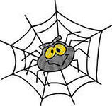
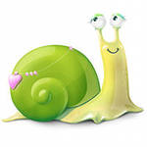
S s
Six slow snails.
Seven spooky spiders!

Slide 21
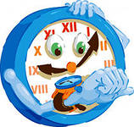
T t
What`s the time? It`s twelve o`clock.
Where`s the train? It`s one o`clock!
Here`s the train! It`s two o`clock!
Tick, tock, tick, tock.
Tick, tock, tick, tock.

Slide 22
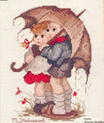
U u
Under the umbrella! Quick!
Don`t get wet! Don`t get sick!
My umbrella is too small.
You are all wet. You are too tall!

Slide 23
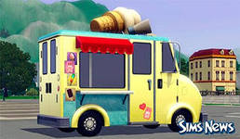
V v
Hurray! Hurray! Hurray!
Say “hello” to the ice cream man.
Hello! Hello! Hello!
Vicky likes vanilla,
And so does Victor!
Say “goodbye” to the ice cream man.
Here comes the ice cream van.
Goodbye! Goodbye! Goodbye!

Slide 24
W w
Wendy the worm doesn`t walk.
Wendy the worm wiggles!
Wendy the worm doesn`t talk.
Wendy the worm giggles!

Slide 25
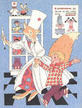
X x
Put six x-rays into a box, Dr Fox!

Slide 26
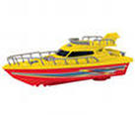
Y y
Sail a yellow yacht on the sea.
Come with me! Come with me!
Sail a yellow yacht on the sea.
We`ll all have fish for tea!

Slide 27
Z z
Zig the zebra has got zigzags.
How many zigzags has Zig the Zebra got?

