Slide 1
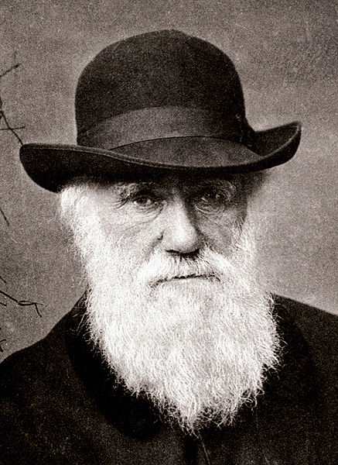
Charles Darwin is a British naturalist who achieved lasting fame as originator of the theory of evolution through natural selection

Slide 2
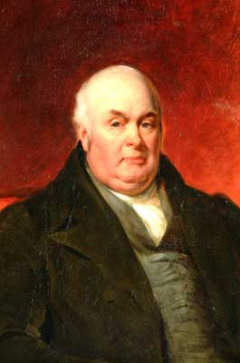
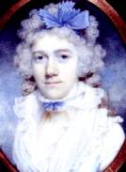
Charles Robert Darwin was born on February 12, 1809 in Shrewsbury, England. He was the fifth child and the second son of Robert Darwin and Susannah Wedgwood.

Slide 3
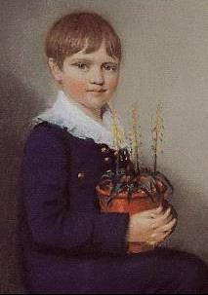
As a boy, Charles collected all kinds of things: minerals, bird’s eggs, insects. He carried out chemical experiments in the school garden. His nickname was “Gas”.

Slide 4
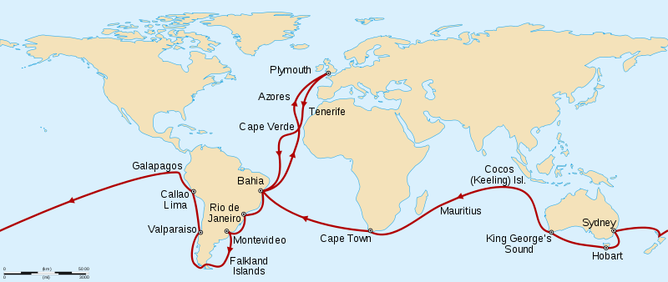
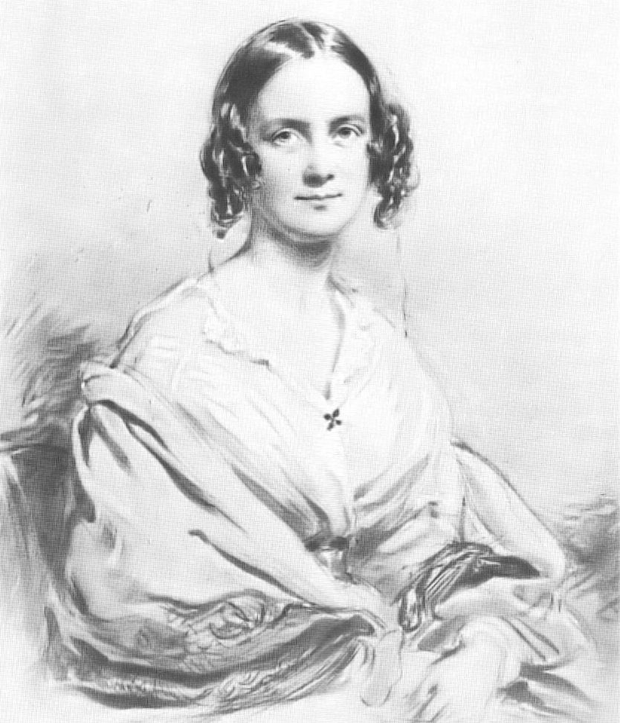
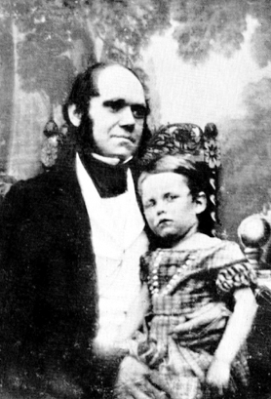
After 3 years of study at Cambridge University he made a voyage round the world. During the 5 year voyage he studied many different kinds of plants and animals.
On 29 January1839 Darwin and his cousin Emma Wedgwood were married. The Darwins had ten children.

Slide 5
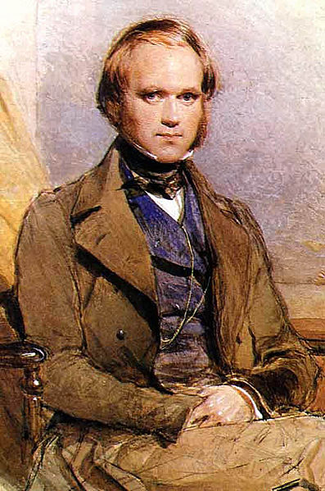
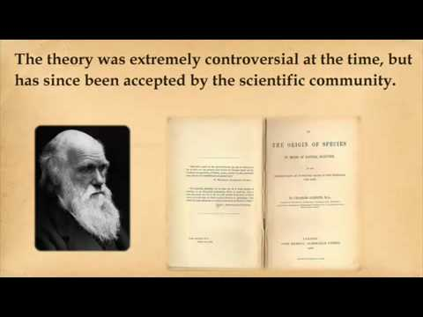
Little by little Darwin built up his famous theory.

Slide 6
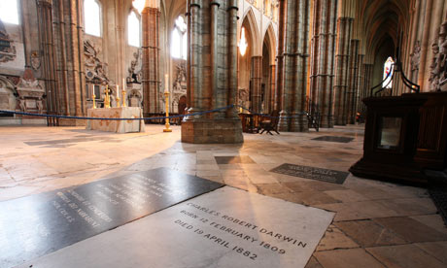
Charles Darwin died on April 19, 1882 and was buried in Westminster Abbey.

Slide 7
Darwin has been commemorated in the UK with his portrait on the reverse of £10 banknotes.

Slide 8
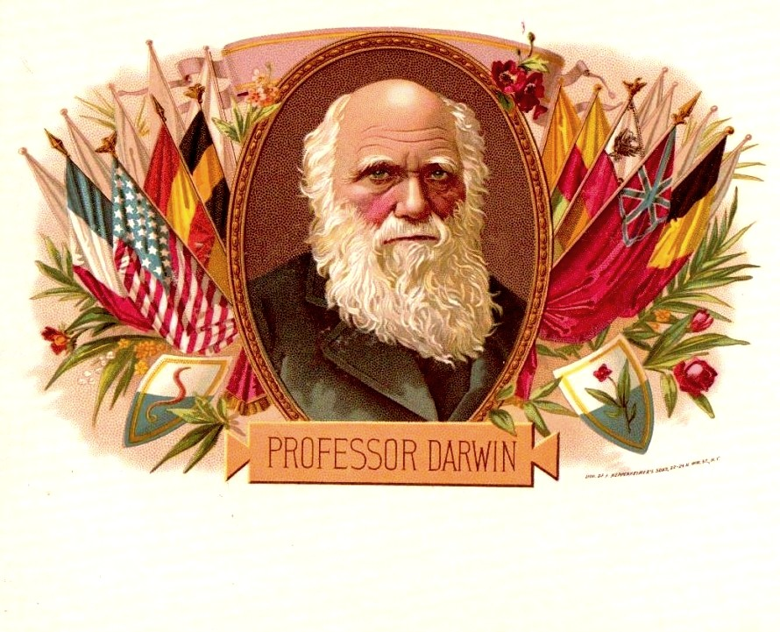
His theory of evolution opened a new period in the development of biology.

Slide 9
Презентацию по теме «Great Minds» подготовила Виктория Жогина 8«В»

