Slide 1
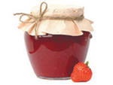
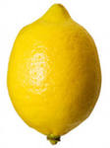
Ex.2 p14
J_m
Jam
_ _m_ _
Lemon
H_nd
hand

Slide 2
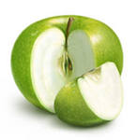
A_pl_
apple
_g_
egg
d_l_
doll

Slide 3
Ink – kite – egg - g

Slide 4
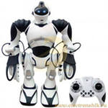
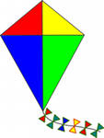
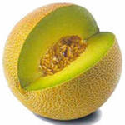
L_ _ _n.
What is this?
It is a lemon
R_b_t
What is this?
It is a robot
k_t_
What is this?
It is a kite
M_ _ _n
What is this?
It is a melon

Slide 5
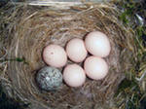
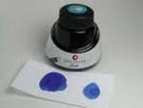
q_ _ _n
Who is she?
she is the queen.
N_st
What is this?
It is a nest.
_nk
What is this?
It is ink.
P_n
What is this?
It is a pen.

Slide 6
[ai] fine, side, slide, nine, line, like
Ii
[i] sit, six, his, this, disk,kiss.

