Slide 1
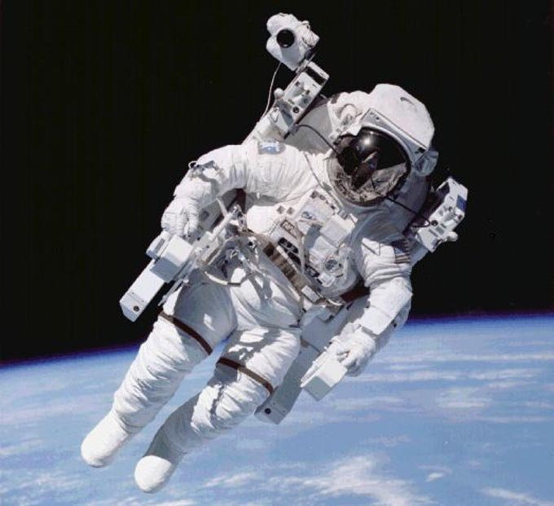
FUTURE LIES IN OUR HANDS
TIME TRAVEL
Браткина Татьяна Павловна
Учитель английского языка
МОУ СОШ №2
г. Кораблино
Рязанской области
2012

Slide 2
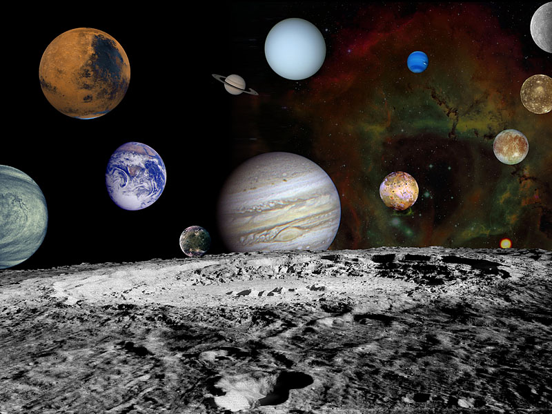
UNIVERSE

Slide 3
Let’s meet
I am | a student, a pupil, a teenager
I am | 14,15,16,17...
I am from | Russia, England, Italy, Spain, the USA, France…
I like I’m fond of I usually/often I have | painting, travelling, swimming, walking, riding, driving, cooking, sleeping; learn, sing, dance, play, read, walk; the Internet, computers, nature, flowers, books, music, sport, my friends, my family, my country, my pets

Slide 4
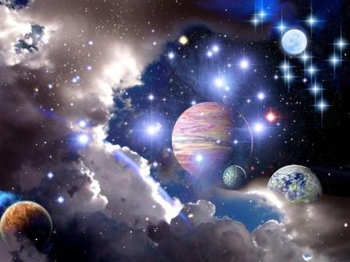
The World After The Year
2050

Slide 5
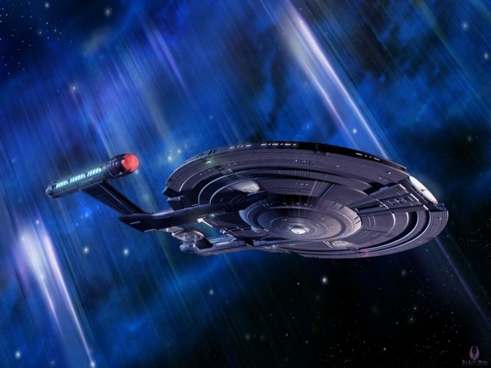
Time Machine

Slide 6
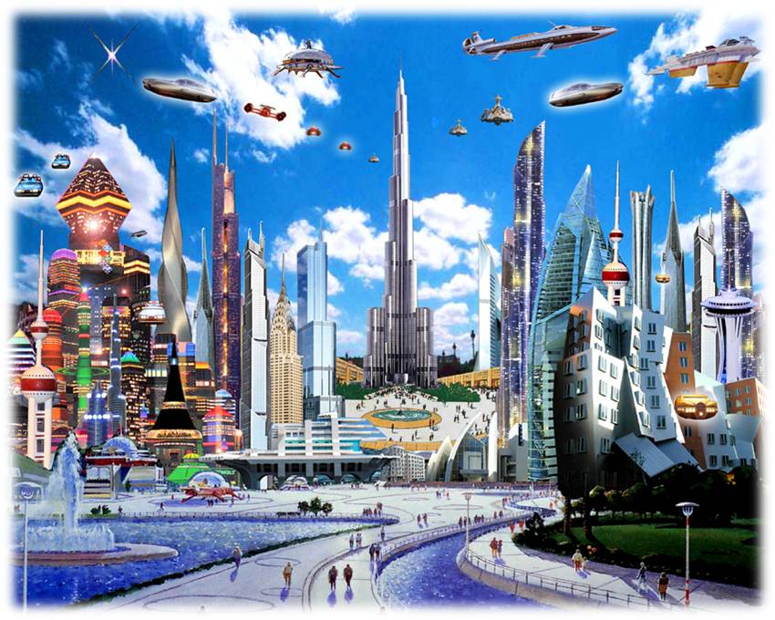

Slide 7
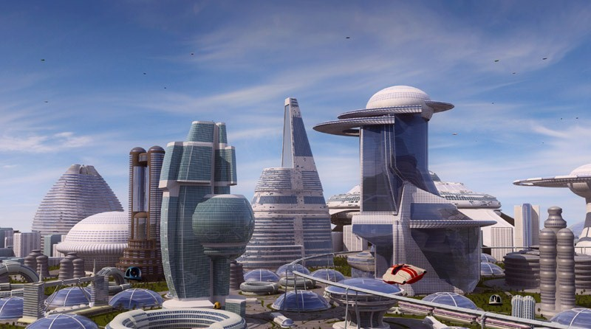

Slide 8
Time Machine

Slide 9
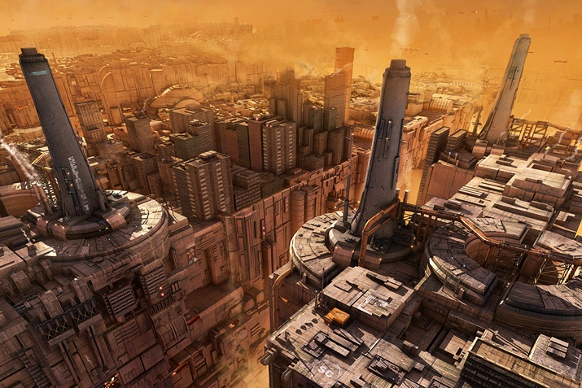

Slide 10
Time Machine

Slide 11
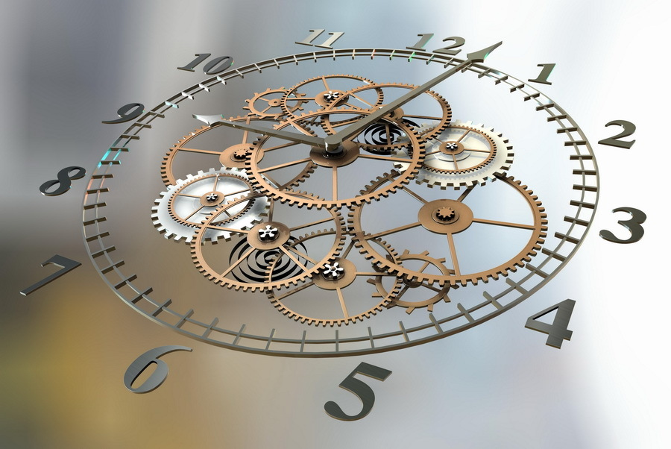
Back to the PAST

Slide 12
Listen to the text and guess what it is about
Leonardo da Vinci, | Aristotle,
Nikola Tesla, | Gagarin,
Columbus, | Plato,
Nicolaus Copernicus,
k. Tsiolkovsky

Slide 13
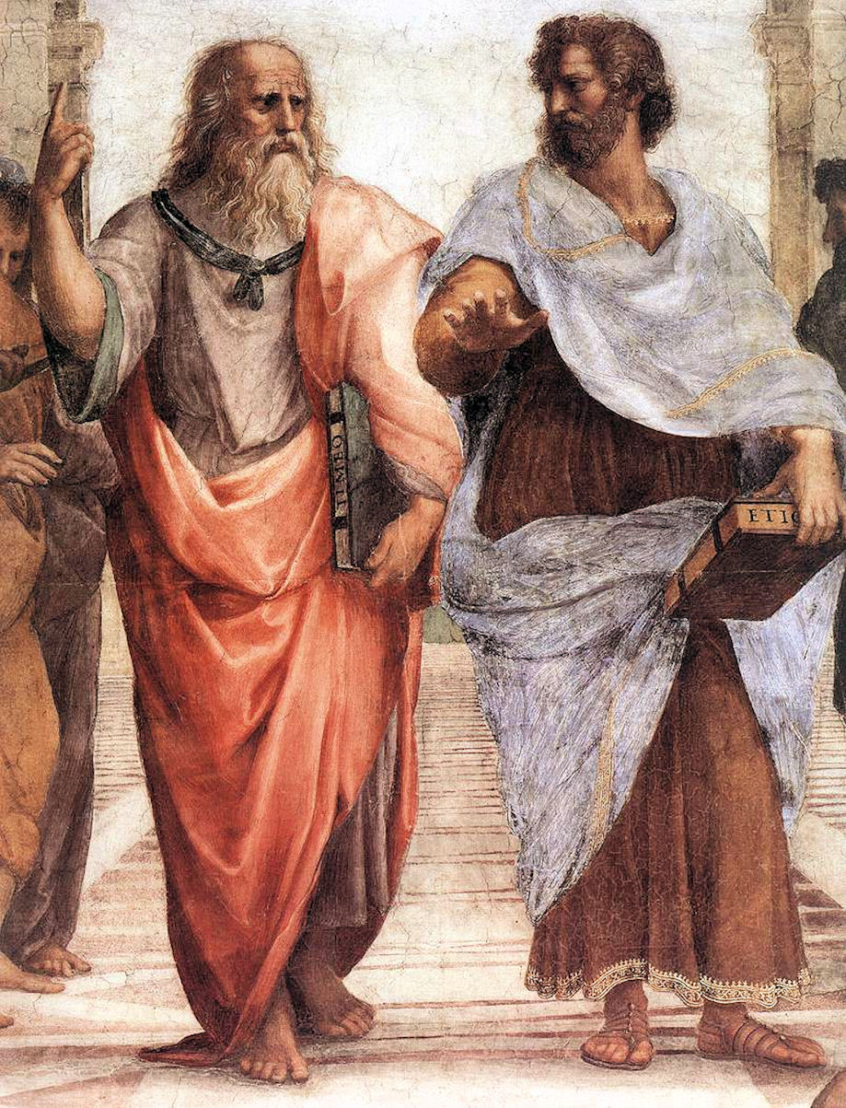
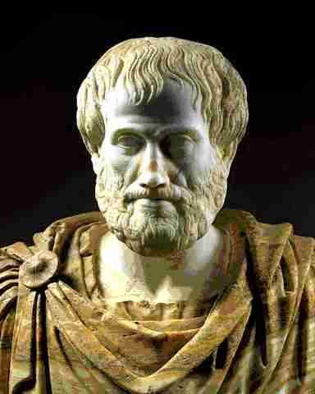
Aristotle

Slide 14
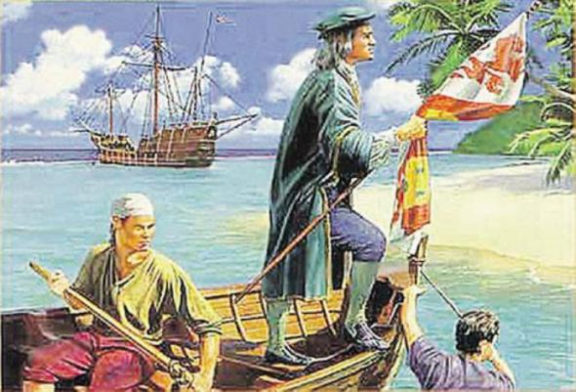
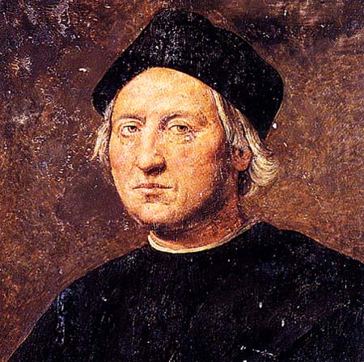
Columbus

Slide 15
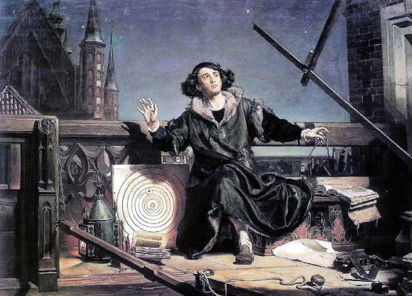
Nicolaus Copernicus

Slide 16
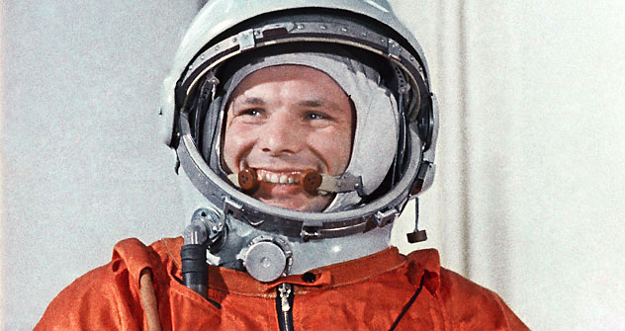
Yuri Gagarin

Slide 17
Puzzle
cool, student, universe,
truth, pupil, history,
future, education,
school, fun, you,
planet, blue,
humanity,
useful

Slide 18
 | You
Education |  | Future
 | Universe

Slide 19
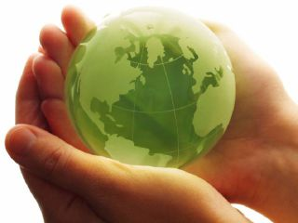
Create Your Future
Your future depends on many things, but mostly on you.
Frank Tyger

Slide 20
Do you like our journey on the Time Machine?
Write a cinquain to show your attitude to the lesson
Example: Future Bright, great, promising, (Or bleak, gloomy and uncertain,) Time that will come after the present Expectation

Slide 21
Homework
Your homework for the next lesson is to write a short composition:
What we should do to make our future better?

Slide 22
Resources
1 слайд - http://img-fotki.yandex.ru/get/3114/kam-shmurodov.0/0_7322_d288b24_XL
2 слайд - http://science.nationalgeographic.com/staticfiles/NGS/Shared/StaticFiles/Science/Images/Content/solar-system-montage-solar-system-xl.jpg
4 слайд – http://www.vashsad.ua/i/gallery/wallpapers/65/1600_1200/iC0S83aE.jpg
5,8,10,20 слайды - http://acunningplan.typepad.com/photos/uncategorized/enterprise_nx01.jpeg
6 слайд - http://ammvizeum.files.wordpress.com/2010/02/d180d0b8d181d183d0bdd0bed0ba12.jpg
9 слайд - http://de.trinixy.ru/pics5/20120208/world_of_the_future_35.jpg
7 слайд - http://www.gaj-it.com/wp-content/uploads/city-8.jpg
11 слайд - http://storage0.dms.mpinteractiv.ro/media/401/781/10668/8097525/1/ceas.jpg
13 слайд - http://netdna.webdesignerdepot.com/uploads/iconic_portraits/dkmb86g_826f7gf2x45_b.jpg
13 слайд - http://loacmateo.files.wordpress.com/2010/11/aristote-11.jpg
14 слайд - http://img15.nnm.ru/d/5/1/f/8/a71983c59ec88946198588035ef.jpg
14 слайд - http://upload.wikimedia.org/wikipedia/commons/1/14/Ridolfo_Ghirlandaio_Columbus.jpg
15 слайд - http://s46.radikal.ru/i113/1005/e2/b230475c333b.jpg
16 слайд - http://mobile.rbth.ru/assets/images/2011-04/top/TASS_gagarin2-top.jpg
19 слайд - http://ecojovenes.files.wordpress.com/2009/04/planeta-verde.jpg?w=455&h=363
19 слайд - http://www.qotd.org/search/search.html?aid=2270

