Slide 1
I and my favourite clothes
Презентацию выполнила :
Конушкина Лиза,
Ученица 6 класса
Руководитель: Конушкина И.Г. ,
Учитель английского языка

Slide 2
My name is lisa. I am 11. I am not very tall and slim. My hair is fair and long. My eyes are green. i have got a straight nose. My friends say that I am pretty.

Slide 3
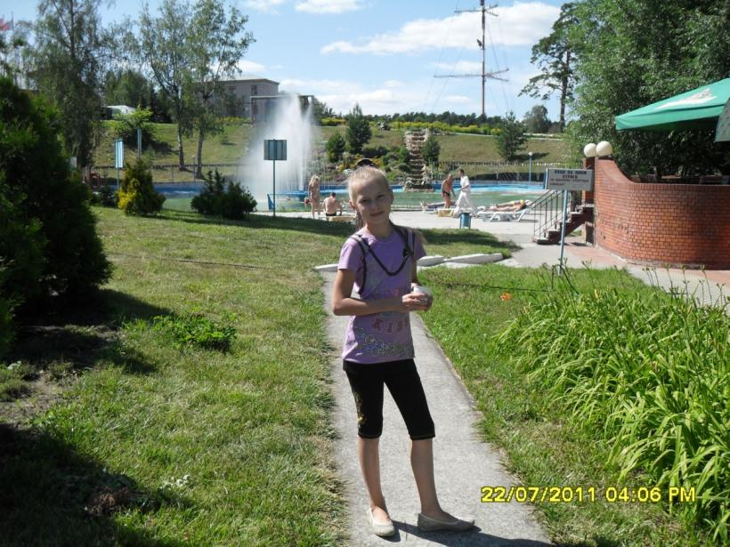
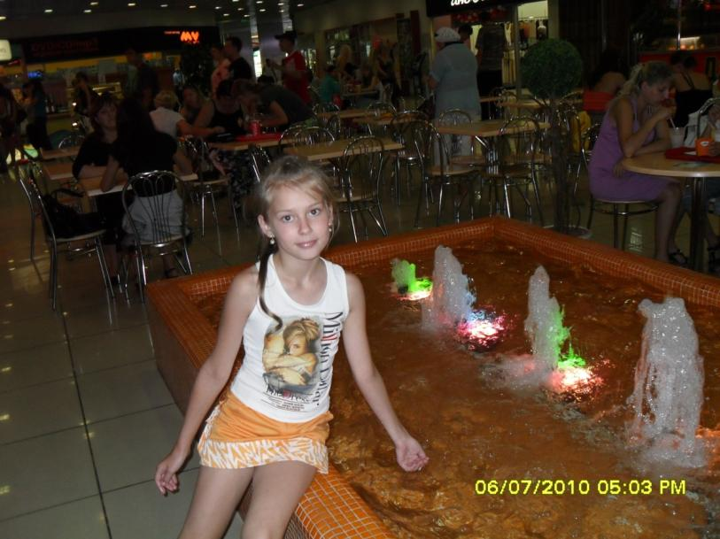
I like beautiful clothes .i like wearing blouses, dresses, skirts, tops, trousers and shoes. And I am carefuLL about my clothes. They are always clean and neat.

Slide 4
This is my favourite dress.It is smart and bright. It is super.

Slide 5
I LIKE THIS TRACKSUIT VERY MucH. IT IS VERY COMFORTABLE.

Slide 6
IF IT IS COLD I WEAR JEANS AND A Jacket.

Slide 7
IF IT IS HOT I WEAR A TOP AND SHORTS.

Slide 8
IF I GO TO SCHOOL I put a UNIFoRM on.

Slide 9
At home I wear a t-shirt and shorts.

Slide 10
I think clothes are very important, they say a lot about the person.

