Slide 1
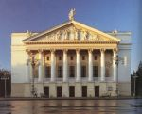
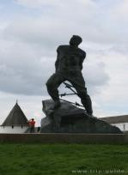
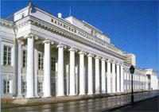
Kazan is the pride of Tatarstan
Welcome to Kazan!

Slide 2
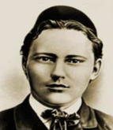
Oh, Kazan! Spirited Kazan! Melodious Kazan! Radiant Kazan! Here are all the solemn places and deeds of our ancestors. Here are all the beauties and the paradise of the yearning soul! Gabdullah Tukai

Slide 3
Kazan is the capital of Tatarstan, one of the biggest economical, scientific and cultural centres of Russia. Full of people, motley, multilingual, Kazan has always attracted people. The origin of Kazan, one of the most ancient cities of Russia, is lost in the depth history. It is probable that a settlement existed on its place before 1005, which is provided by archeological discoveries. Kazan is situated on the picturesque banks of the Volga river. It has a population of 1.2 million people. The heart of the city is its people, be it Tatar, Russian or other of the 70 nationalities who have settled over the centuries in Kazan.

Slide 4
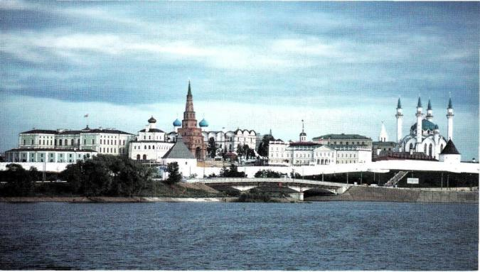
The Kazan Kremlin
The object of worldwide heritage UNESKO. Situated in the area of ancient Kazan fortress. Its architectural complex had been based during XVI-XIX centuries. The construction of Kremlin was begun by popular Pskov architects managed by Postnik Yakovlev and Ivan Shiryi.

Slide 5
The Kazan Kremlin occupies a special place in history. It has seen various changes and has always played the central role in the region. In the 10th century it was a small settlement. In the 10th -13th centuries it became a fort. From the 13th century the Kremlin became the centre of the Kazan khanate. In 1552 Ivan the Terrible recaptured Kazan. The old fortress was rebuilt as a russian Kremlin. From 1708 the Kremlin became the centre of the first kazan district of the Russian Empire. Kazan was called “the third capital of Russia”, “the fairest and best city of all Russia after Moscow and Saint Petersburg”

Slide 6
Opposite the Savior Gate of the Kazan Kremlin stands the two-storey building of the Gostiny Dvor, where the State Museum of the folklore, history and economy of Tatarstan is located. Empress Catherine II traveled to Kazan in 1767 and wrote to Voltaire in France : «I am in Asia. In Kazan there are 20 different people who are nothing like each other». This museum posses beautiful collection of folk costumes. The decorated boots, ichigs, became part of the Tatar’s national costume. The organized manufacturing of ichigs began in the middle of the 19th century, and by the end of the century 12000 craftsmen were involved in its manufacturing. Their work won gold medals in Chicago, Paris and Copenhagen and was sold not only in Russia and Asia, but also in Western Europe.

Slide 7
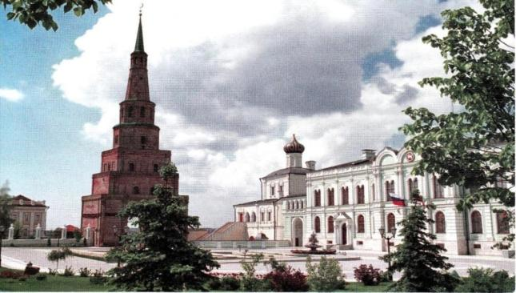
kREMLIN, Governor mansion complex
It was built in 1845-1848. The complex comprises as well: Palace church of 17th century. Suyuembike Tower was bult in 15-17 centuries by the type of so called watch towers and represents seven-leveled construction. Its height is 58 meters. The tower refers to the number of the falling towers. Its bend is 1.8 meters.

Slide 8
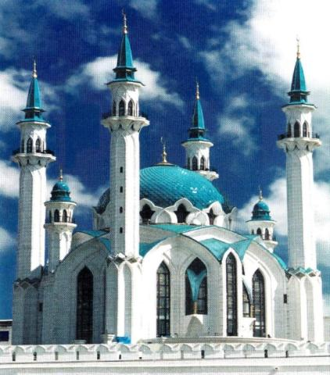
Kremlin. Kul Shariff mosque.
Construction of Kul Shariff mosque began in 1996 by the project of groop of architects of the Tatinvestgrazhdanproect company. Named in honour of imam Seid Kul Shariff (XVI century).

Slide 9
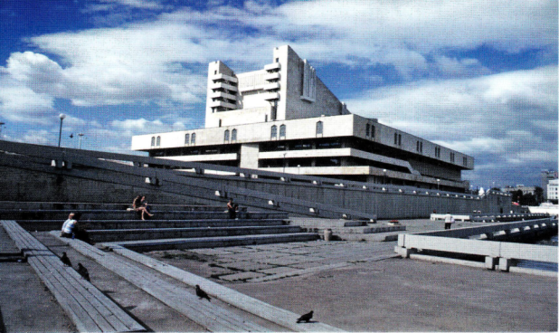
G.Kamal state academic theatre
G.Kamal theatre is established in 1906. Present day building is constructed in 1986 by architects Gorlishkov and Agishev in the style of neoconstructionism with elements of tatar decorative art.

Slide 10
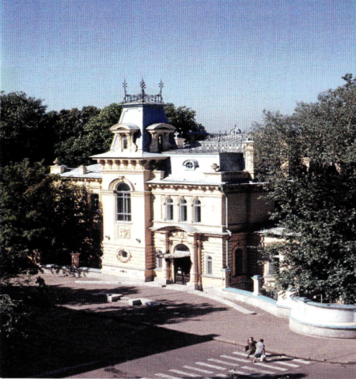
The mansion of Commander-in-chief of the Kazan Military district
It was built in the beginning of the 20th century by the project of architect Mufke. There is a state museum of fine arts of Tatarstan republic in this mension now.

Slide 11
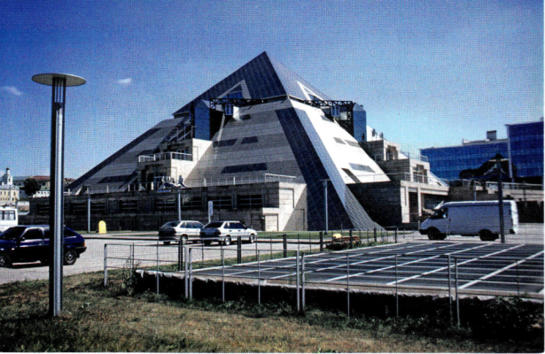
Pyramid-cultural-intertainment complex
It was built in 2002. The owner of idea is R.M.Shaimiev, architectural decision – G.S. and V.S. Tokarevs.

Slide 12
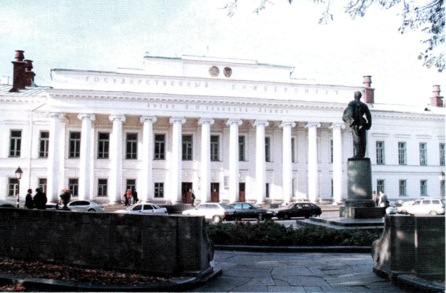
V.I.Ulyanov-Lenin state university
It was established in 1804. For 200-years history of university in its libraries and nine museums had been collected lots of monuments of history and art.

Slide 13
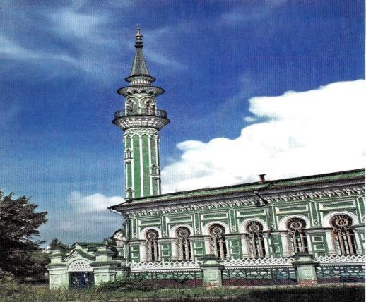
Azimov mosque
Built in 1890 on donations of merchant M.M.Azimov by project of unknown architect. One of the best mosques from architectural point of view.

Slide 14
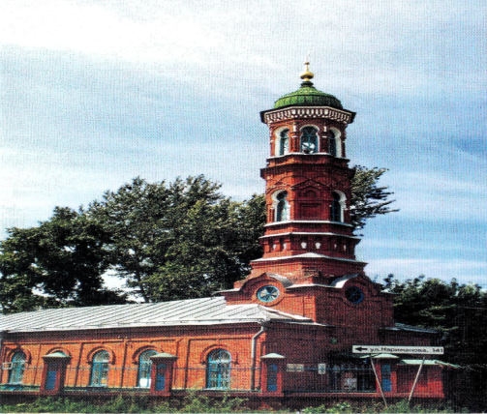
Burnayev mosque
It was built in 1872 by the project of architect Romanov by merchant M.K.Burnayev.

Slide 15
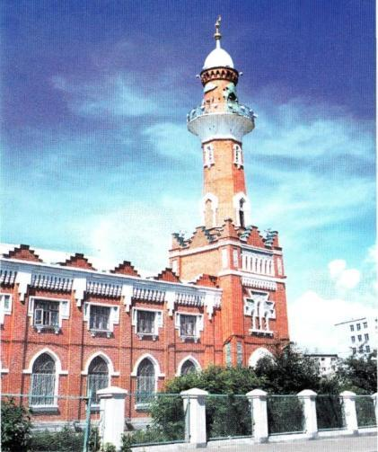
Zakabannaya mosque
Built in 1924-1926 in honour 1000 years anniversary of acception islam in the middle Povolzhie on public donations by the project of architect A.E.Pechkov.

Slide 16
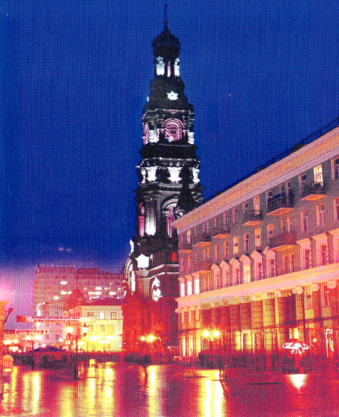
Bogoyavlensky cathedral
Built in 1741 on donations of merchant S.A. Chernov. Fedor Ivanovich Shalypin was christened here on the 2nd of February in 1873. The belltower was built on donations of merchant I.S.Krivonosov in 1897 by architect M.D.Michailov. The height is 74 meters.

Slide 17
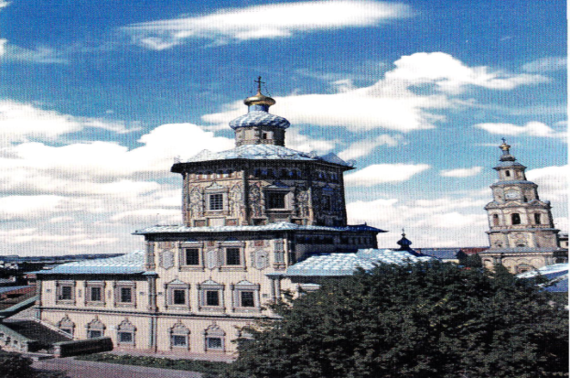
Cathedral of supreme Apostoles Peter and Paul
Built in 1726 by merchant I.A.Mikhlaev in Honour of Peter I visiting Kazan city in 1722.

Slide 18
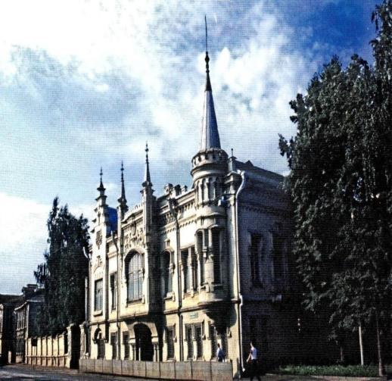
House of Shamil
Built in 1903 by merchant Ibragim Apakov. The designers are Fedor Amlong and Genrich Rush. The mansion was presented as a gift for Apakov’s daughter in wedding day and son of prominent imam Shamil. There is the Tukai literary museum in this house from 1986.

