Slide 1
School № 4
Has Executed
Pupil 7 classes
But Secondary school 4
Kozilo Evgeniy.

Slide 2
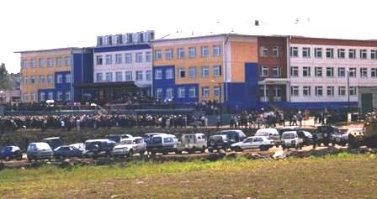
My favourite school.

Slide 3
Do you love going to school?

Slide 4
What’s your subject?
I study English, Russian language, Literature, Art, Geography, Geometry, Algebra, Physics, PE, History, Biology, Technology, Informatics.

Slide 5
What’s your favourite subject?
My favourite subject is Algebra because I get A's and B's in it.

Slide 6
School impressions.
My school was built in 2006. There are two athletics common-rooms and two computer rooms.
There are many skillful teachers in my school.
I love my school very much.

