Slide 1
My favourite clothes
made by
Valera Lavrik
Form 6 “A”

Slide 2

I like wearing
A red T-shirt
Blue jeans
Yellow trainers

Slide 3
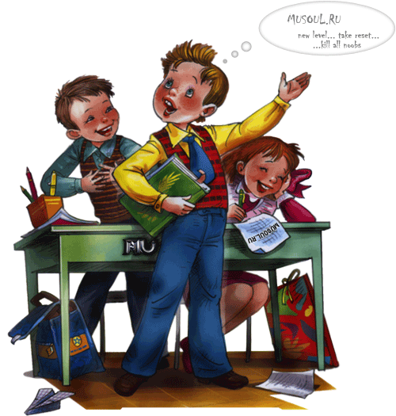
My school clothes are
Trousers
A shirt
A jumper
And shoes

Slide 4
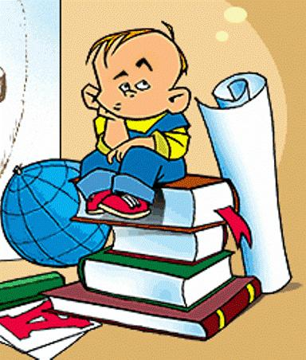
Guess the words
forblecomta
userstro
rktiuacst
nfrmoiu

Slide 5

Congratulations
comfortable
trousers
tracksuit
uniform

