Slide 1
My school

Slide 2
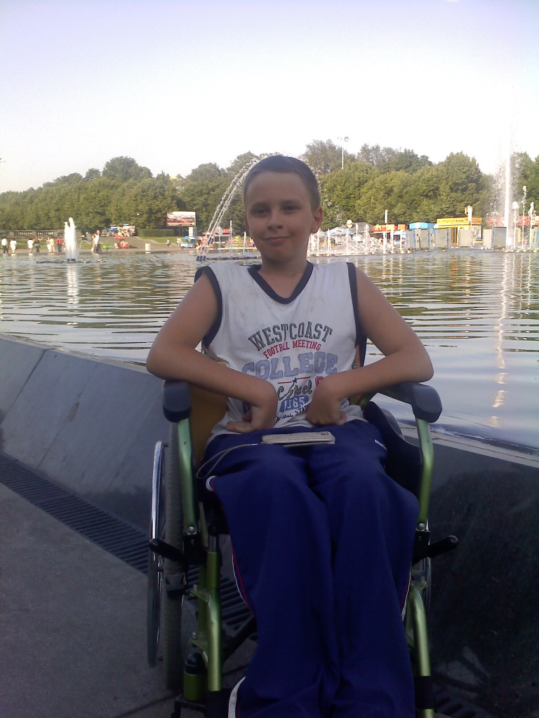
My name is Yegor. I am twelve. I am kind, shy, responsible can keep secrets, cute

Slide 3
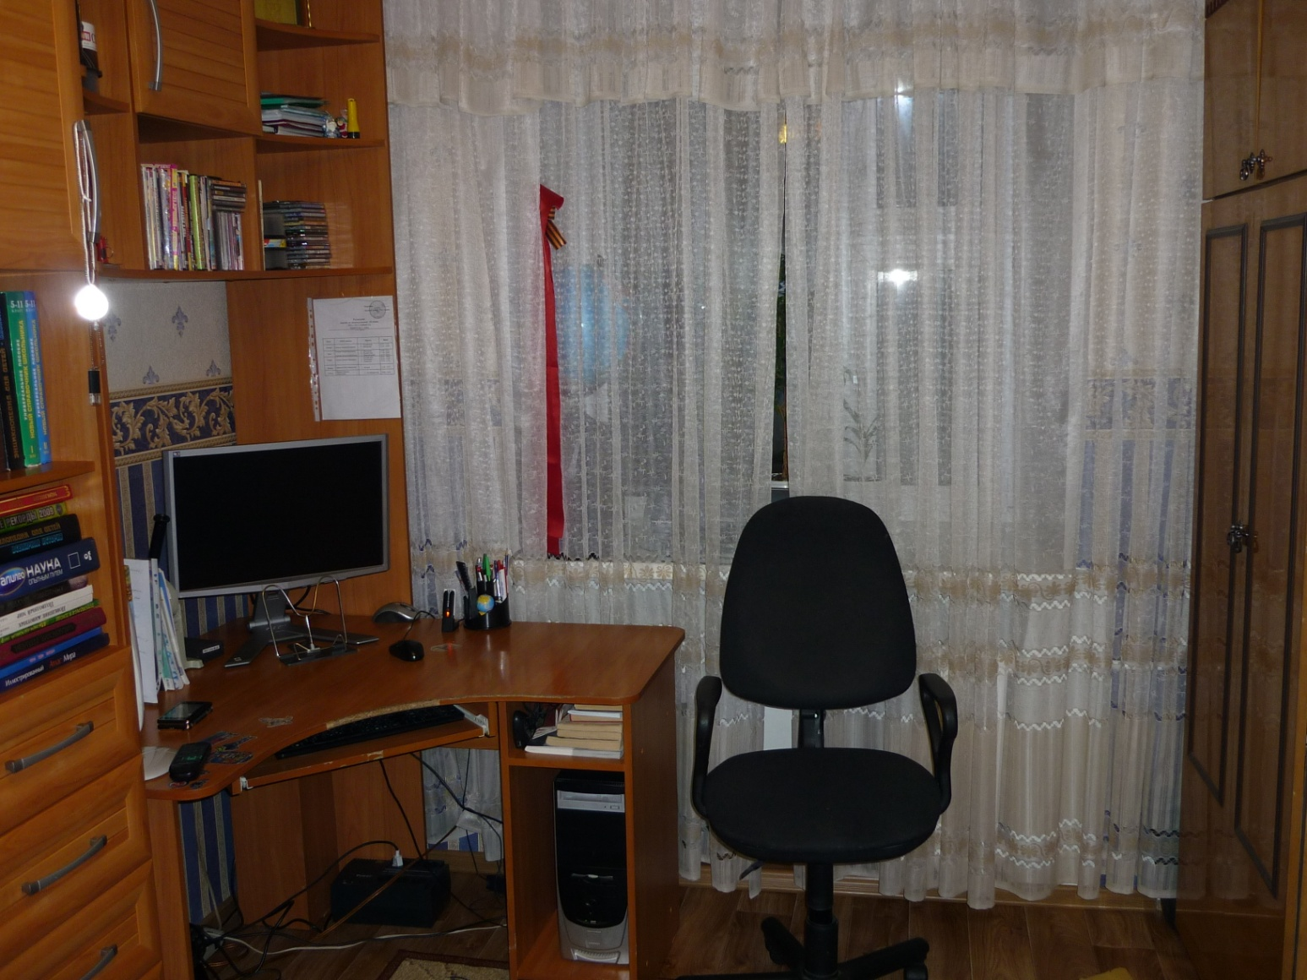
It’s my classroom

Slide 4
School subjects we study
Russian language
Maths
Nature
Literature
History
English language

Slide 5
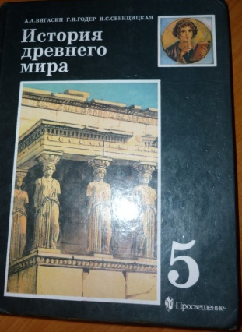
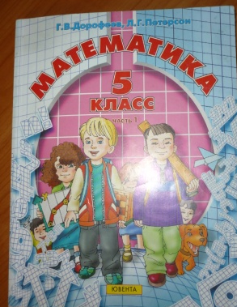
My favorite subjects
History
Maths

Slide 6
Why do I like these subjects?

Slide 7
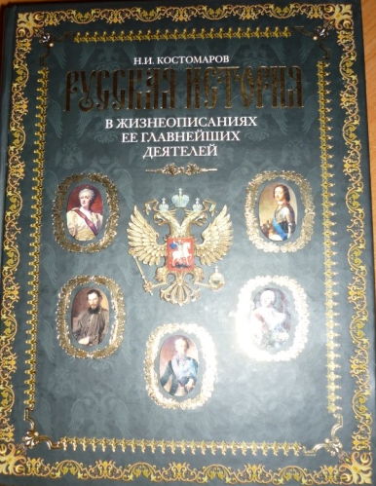
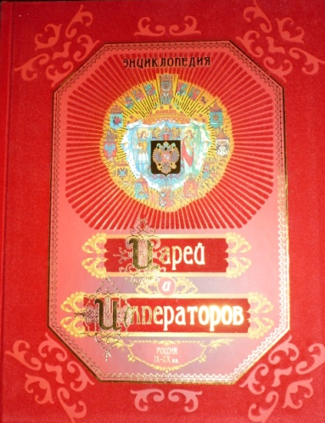
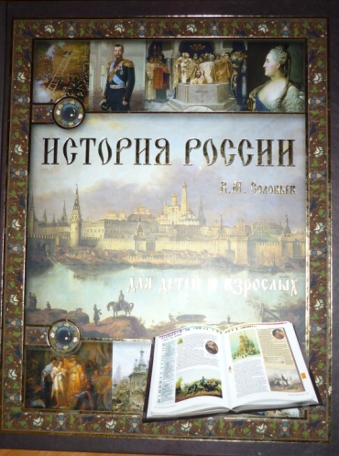
History
I like History lessons, because I want to learn a lot about the history of Russia.
I have a lot of interesting books about history of the Earth

Slide 8
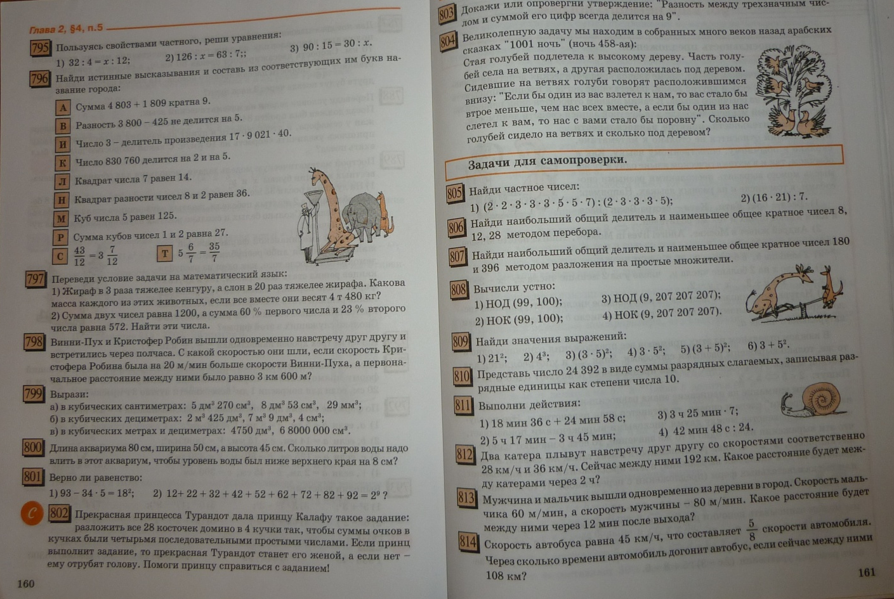
Math
I like Maths, because I want to solve different tasks.

Slide 9
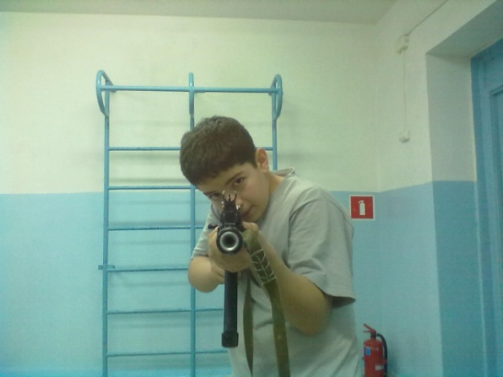
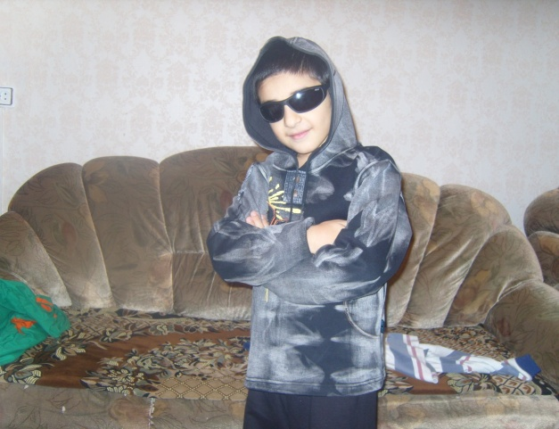
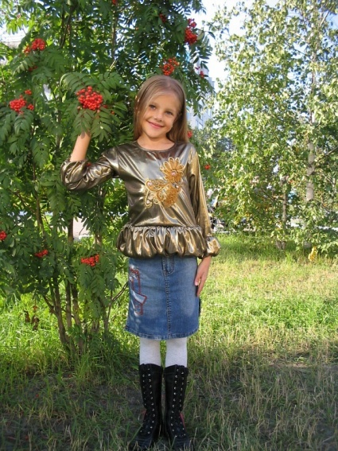
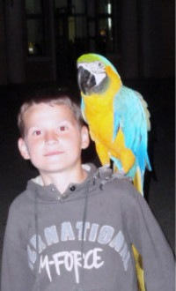
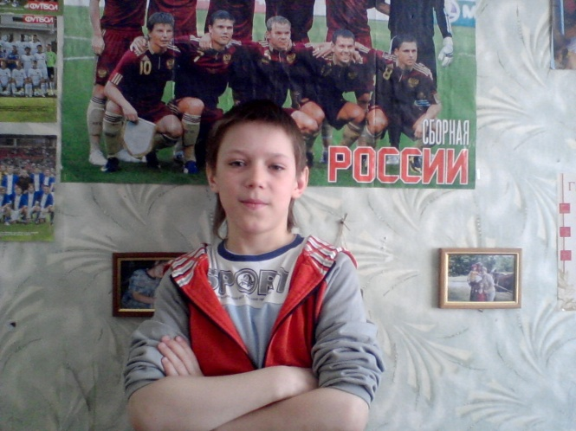
My school friends

Slide 10
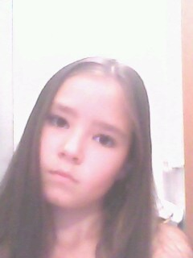
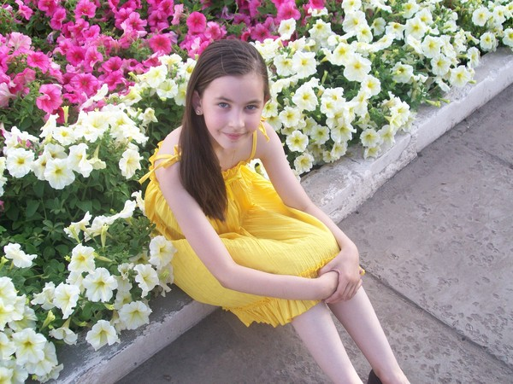
My pen friends

Slide 11
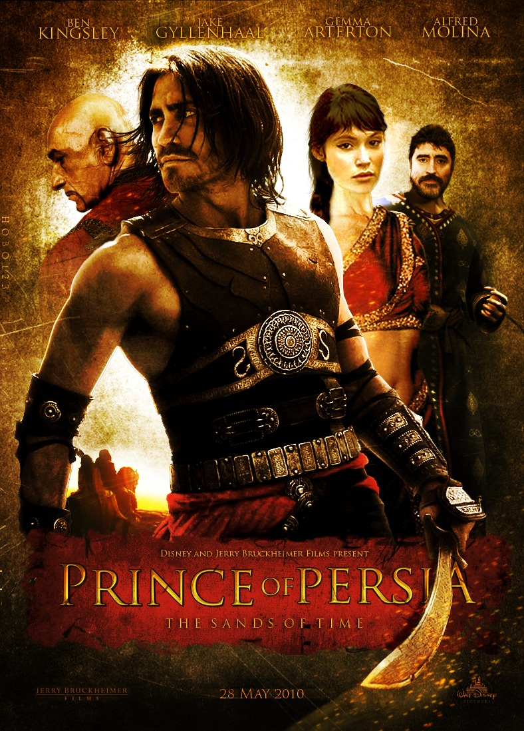
We share with our opinions about films, books, and school.

Slide 12
My dream
My dream is to stand on my feet

