Slide 1
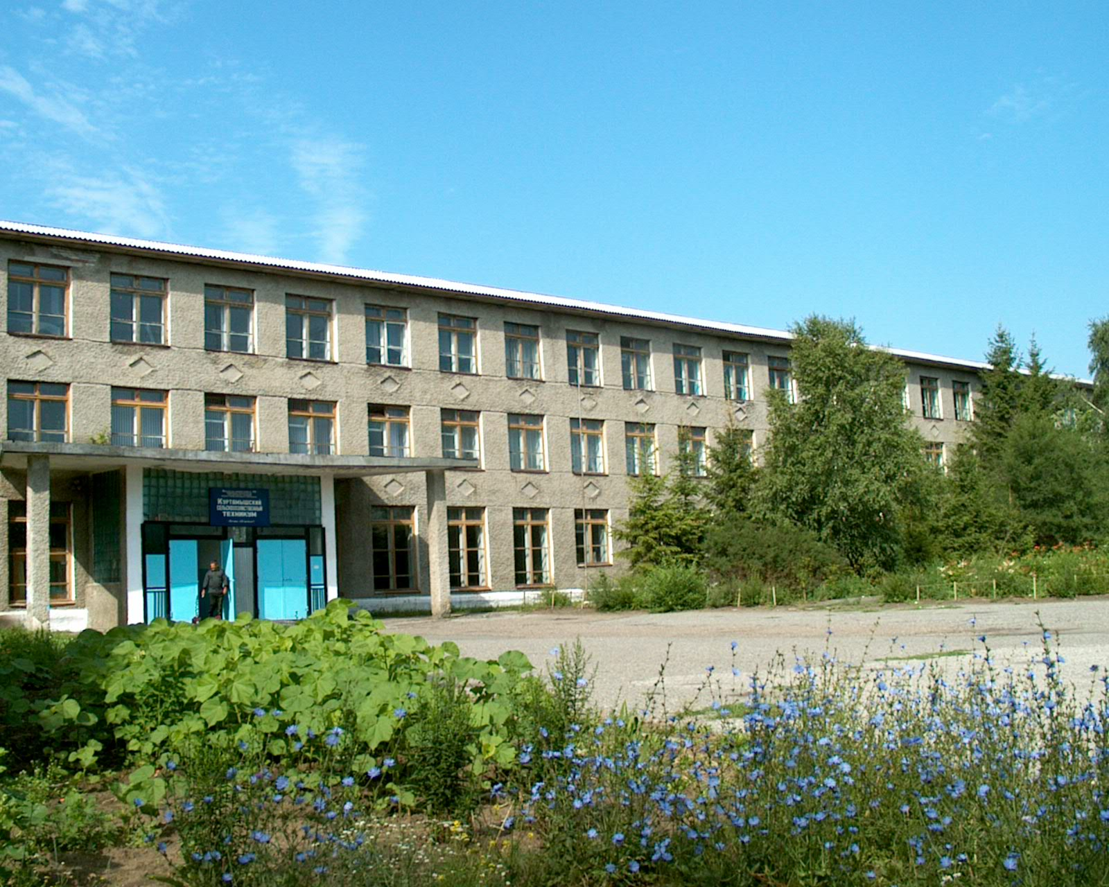
Our technical school

Slide 2
My name is Peter Ivanov. I am a full-time first-year student of Agricultural Technical School in Kurtamysh. It was founded in October 1930. Our technical school is in the Student’s street. Our technical school is far from my house but I can easily get there by bus. It takes me 25 minutes to get to the technical school. Sometimes I go there on foot. And though it takes me an hour, it is healthy to walk.

Slide 3
Our technical school occupies two buildings. It runs full-time and part-time departmens. There are six departmens at our technical school: autoservice, economic and book-keeper’s calculation, organization of the land use, mechanization of agriculture, operating of computer, electrification of agriculture. Our technical school trains computer operators, electricians, book-keepers, car mechanics, land-surveyers. Students learn not only the trade but get a complete secondary education. Our students can continue their study at Agricultural Academy in Kurgan.

Slide 4
Our studies begin at 8.30 (half past eight).Usually we have six (eight) hours (periods) a day. We have a lunch break at 11 o’clock. We have a good canteen and during our lunch period we take our meals there. There is a gym (gym hall) on the ground floor. Our library is open from 9 a.m. till 8 p.m. in the term-time. There is a large reading-hall in our technical school and we often do our homework there. Our classrooms and laboratories are large and light. Our labs have modern equipment. The workshops where we have practical training are on the ground floor.

Slide 5
The academic session begins on the first of September and ends in June. Every day we attend lectures and have practice. I do well because I want to become a good specialist. At the end of the term we’ll take exams and I’ll try to pass them successfully.

Slide 6
Some of our students live in the hostel. It is not far from our technical school. It takes them ten minutes to get to the technical school. The life of our students is very interesting. Many of them are fond of sports, because sports help to keep in good health. They take part in sport competitions. The most popular kinds of sport in our technical school are football, basketball, gymnastics, wrestling.

Slide 7
“Time is money”. I think that many of us know this very clever proverb. It says that nobody must lose time. We must spend our time only on useful and really necessary things. We must study and work, read books. But certainly we must rest. Our leisure is a matter of great importance for each of us.

Slide 8
Some students take part in music competitions, concerts. Very active students can travel in summer to south to the Black see (Anapa, Sochi). They rest and work there. Sometimes the best students travel to Ekaterinburg to Aquapark, toTyumen to Hot Springs.

Slide 9
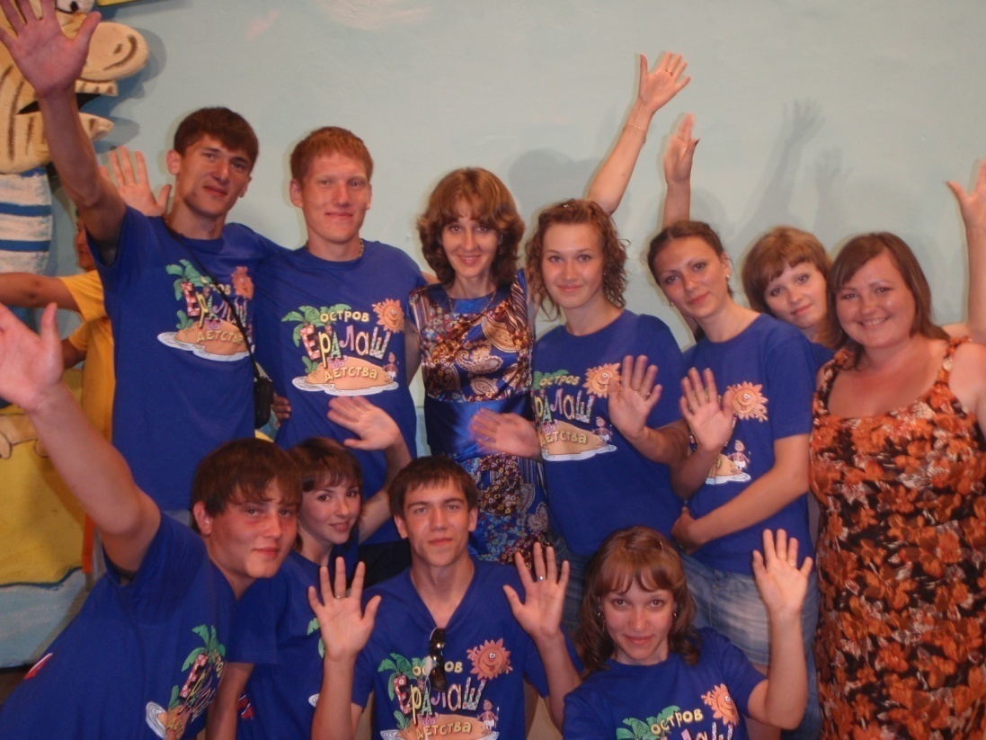
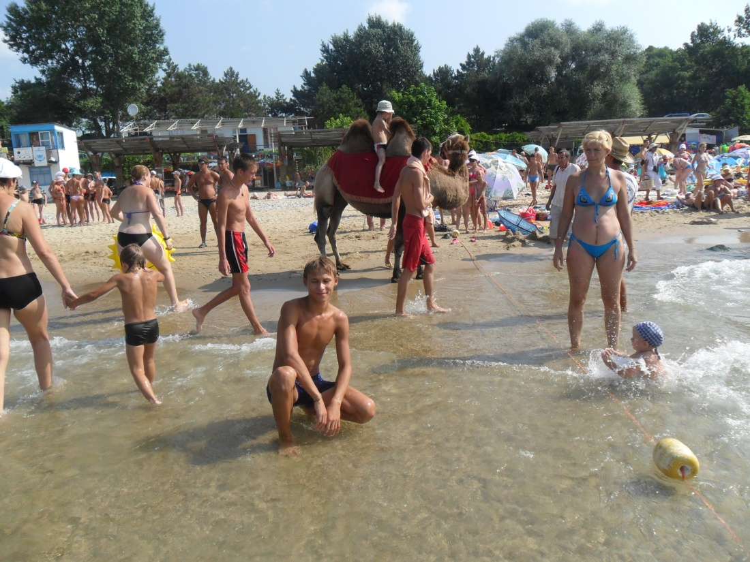

Slide 10
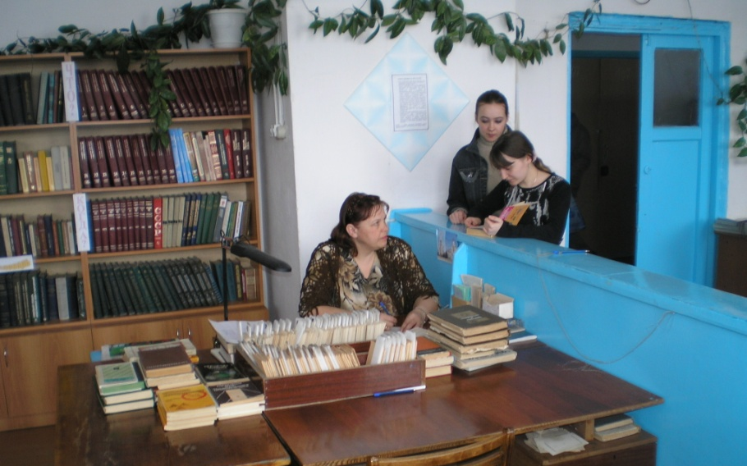
At our technical school we also have classrooms for foreign languages. Our English classroom is on the second floor. Here we have English classes. They are very interesting. We read texts, we speak English, and we listen to spoken English in records. We learn many facts about English-speaking countries, about famous people, speak about writers and read extracts from their books. We read special texts.

Slide 11
The great German poet Goethe said, “He, who knows no foreign language, does not know his own one”. Learning foreign languages is especially important nowadays. Some people learn languages because they need them in their work, others travel abroad, for the third studying languages is a hobby. Every year thousands of people from Russia go to different countries as tourists or to work. They can’t go without knowing the language of the country they are going to. A modern engineer or a worker cannot work with an imported instrument or a machine if he is not able to read the instruction how to do that.

Slide 12
What is hardware? Webster’s dictionary gives us the following definition of the hardware – the devices composing a computer system. Computer hardware can be divided into four categories: 1 input hardware 2 processing hardware 3 storage hardware 4 output hardware Input hardware Input hardware collects data and convents them into a form suitable for computer processing. The most common input device is a keyboard. It looks very much like a typewriter. The mouse is a hand-held device connected to the computer by a small cable. As the mouse is rolled across the desktop, the cursor moves across the screen. When the cursor reaches the desired location, the user usually pushes a button on the mouse once or twice to give a command to the computer. Another type of input hardware is optic-electronic scanner. Microphone and video camera can be also used to input data into the computer.
Texts from our lessons

Slide 13
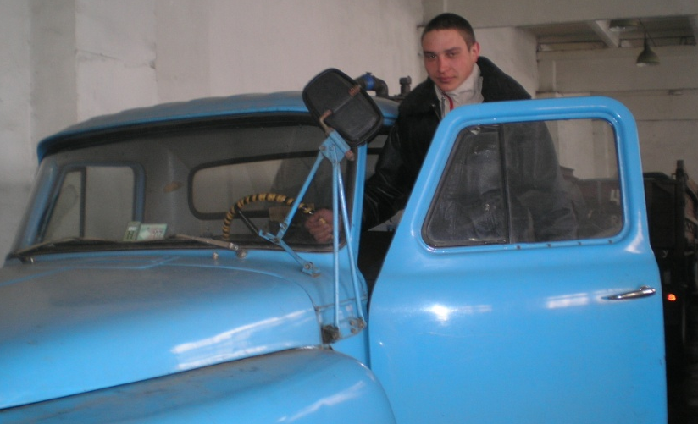
My first driving lesson
Dad stopped the car on a deserted country road, and we changed seats. He had taught me before how all the pedals and levers worked, and I felt proud of myself as I sat at the controls. “Nothing can be easier than driving”, I thought.
“Don’t say another word, Dad! I know what to do,” I said.
I pressed on the clutch pedal with my left foot, fiddled with the gear lever, and at last stamped on the accelerator. The car did not budge. Oh! The hand –brake was still on! I released it and the car began to move. With a shock I found out that we were travelling backwards. Dad laughet to himself . I pulled on the break and tried again. This time the car at last began to run smoothly. I tried to change gear. There was a terrible noise which made us both shudder.
I took my eyes off the road to look at what I was doing and when I glanced up, a big bus slowly approaching us. The road was very narrow. I braked as I could, jumped out and shouted, “Take over, Dad!”
My ears burned with shame as I sank into the front passenger seat.

Slide 14
These are warning notes for some things: 1)-Unplug the unit before filling it with water. -When you finish the work, unplug the unit and empty out any remaining water in tank. -Avoid any contacts with the steam jet to prevent burns. ? ( a camera, an iron, a toaster, a kettle)
2)-Avoid touching the hot metals parts of the unit.
-Slices of bread in the unit may burn. For this reason, do not use the unit near flammable objects.
-Do not operate the unit lying on its side-this could cause a fire!
-Place the appliance in a clear space to allow the necessary air to circulate.
? (a camera, an iron, a toaster, a kettle)

Slide 15
American Cars (By Dacia Campbell) Let’s take a ride in one of our cars. Do you like music? Some of our cars have stereo radios with cassette and CD players in them. Some big cars even have televisions and video machines! Many people have telephones in their cars too! Have you ever called home from your car? In our cars we have windows that roll up or down by touching a button. And you can lock and unlock the doors by pushing a different button. Almost every car has a heater and an air conditioner to keep us warm in the winter and cool in the summer. We love our cars and we spend a lot of time in them. Some cars will tell you the outside temperature and what direction you are travelling (north, south, east or west).I’ve even seen cars that talk to you! Can you imagine a car telling you to put your seatbelt on? Most Americans always wear a seatbelt.

Slide 16
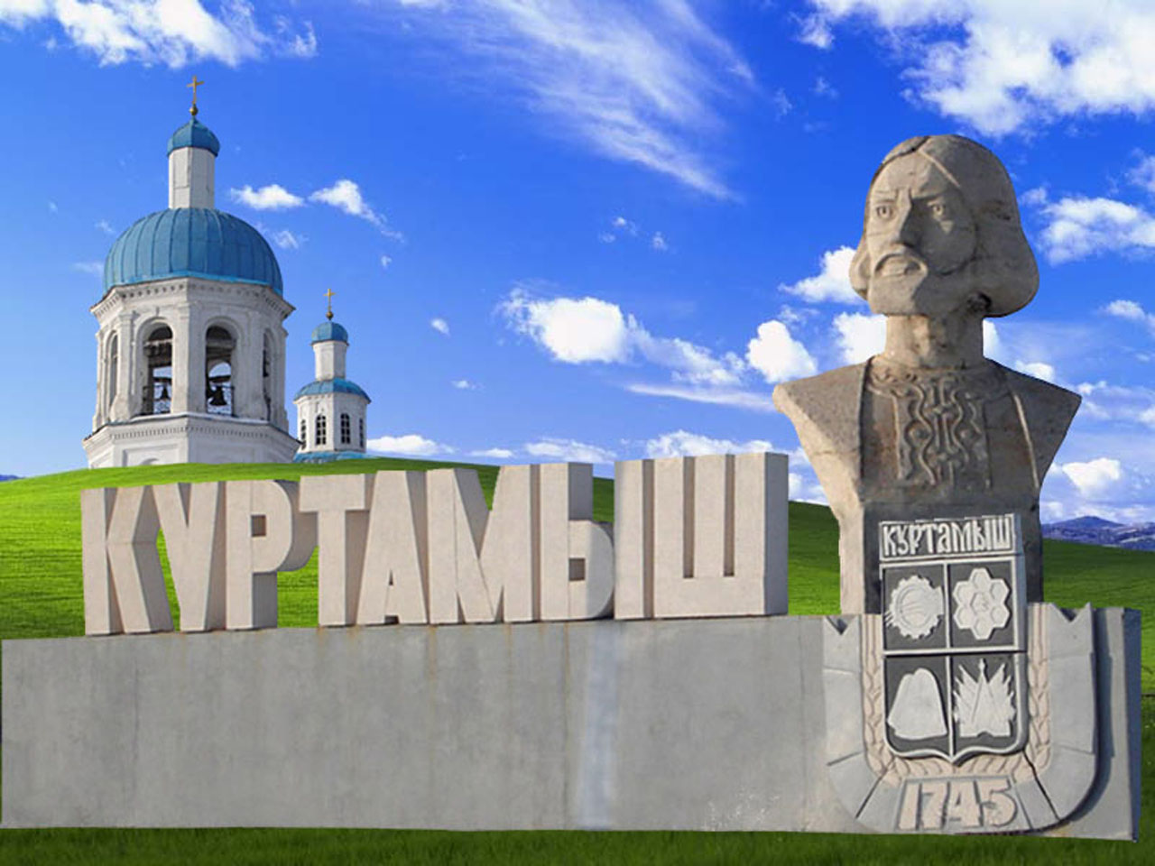
Kurtamysh
Kurtamysh is small town. It is situated on the Kurtamysh River. The date of the foundation of the town is July 1745. It was founded by the Okunyowka peasant Anton Loskutnikov, who built his house on the bank of the Kurtamysh river. The first industrial enterprise appeared in Kurtamysh produced briсks. Kurtamysh was a merchant town. It was built mainly with small wooden houses. There are any enterprises in the town: sewingfactory, woodprocessing enterprise, many bakeries, carrepair workshops, baker’s, grocery stores, green-grocery stores, department stores. These are very big shops where many various goods are sold under one roof.

Slide 17
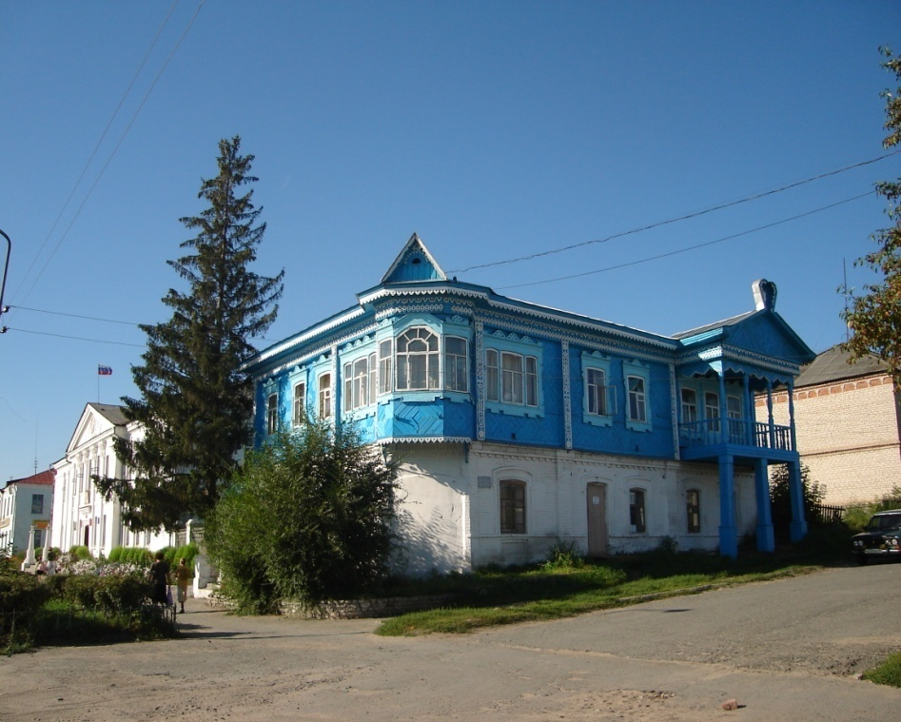
The populatin of the town is about 18.000 inhabitans. Kurtamysh is the cultural center of the district. There are some libraries, District hospital, some chemist’s shops. There is a Museum of Regional Studies, House of Culture. We have two secondary schools, some kindergartens, children’s home. Kurtamysh is the town of students. There are Agricultural and Pedagogical Technical Schools in our town. Our youth is fond of sports and spends a lot of time out-of-doors. There are some stadiums, sport clubs and sports grounds, a ski centre, a skating-rink. There is a monument to the people who died during the Great Patriotic War in the center of the town, in front of it is the eternal fire.

Slide 18
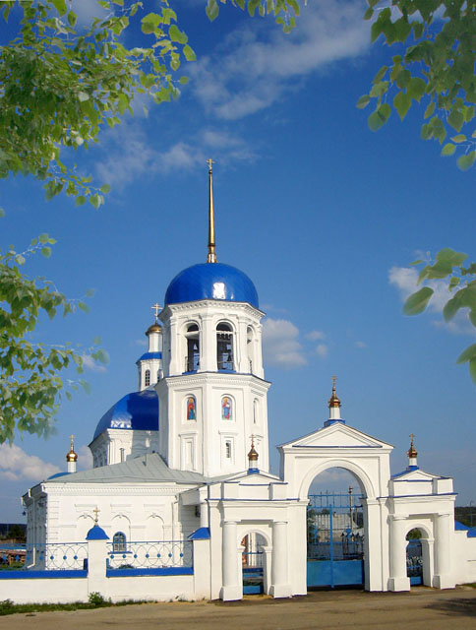
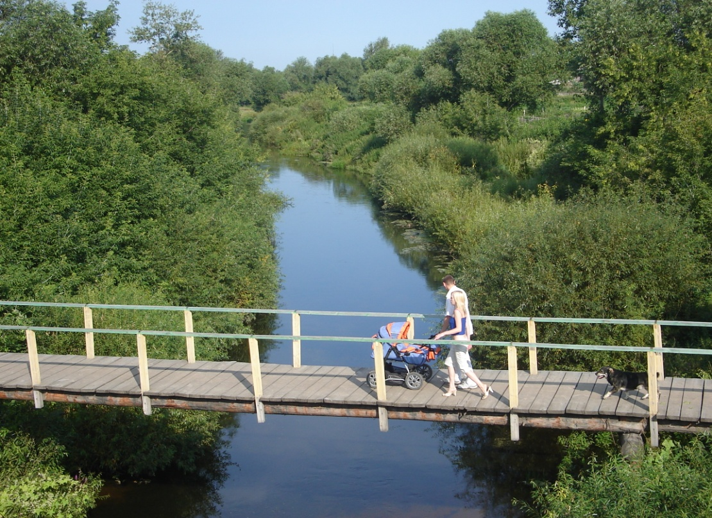
Kurtamysh is famous for its St.Peter’s and Paul’s church. It is a symbol of our town. The gold domes of church shine in sun. There are many old merchant brickhouses. The heart of the town is Lenin square with Lenin monument.
My native town is very beautiful. There are many green parks, large squares, wide and small streets. On the territory of Kurtamysh District are there many forests, many berry and mushroom places, hunting lands and fishing lakes.

Slide 19
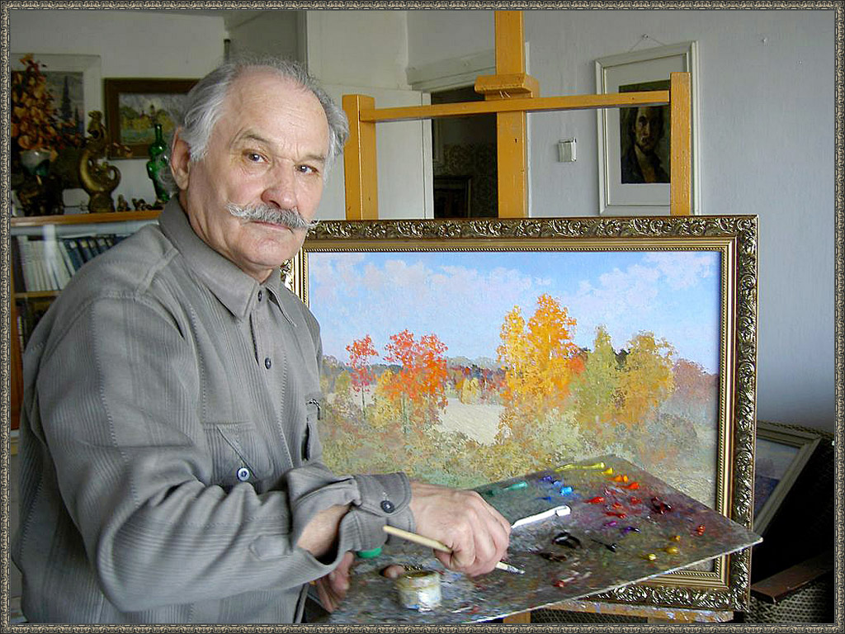
Well-known is the lake near village “Uzkovo”. In summer tourists come here to rest and to lay in the sun. They swim in warm and special water of these wonderful lake.
Kurtamysh is famous for some outstanding personalities. The names of the doctors G.A.Ilizarov, K.I.Zolotavin, J.S.Talyzin , writers N.A.Glebov, A.K.Yugov, P.Z.Kochegin , poets V.J.Malkov, T.M.Belozerov are known all over the country. The District hospital is named after well known doctor K. I.Zolotavin. We can see many beautiful pictures, paintings of known painters N.P. Ustyuzhanin, A.A.Svinkin in Regional Museum.

Slide 20
Our town is very beautiful in all seasons of the year. But most of all I like to walk in the forest in winter. It is frosty, but everything is quit still. There is much snow on the roads, in the fields, in the forest. The trees are white with snow too. But at the same time winter is a good time for sports. We can skate and ski in winter. It is very pleasant to go skiing in the forest on bright sunny days.

Slide 21
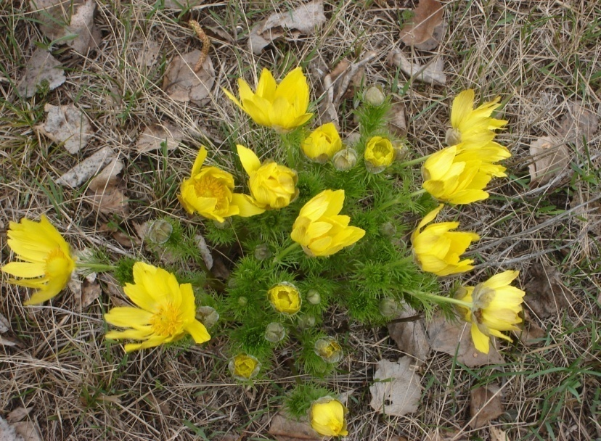
Spring is a beautiful time of the year too. Nature is awakening from the winter sleep. The weather is fine. The sky is blue, the sun shins brightly. The first spring flowers appear (snowdrops, lilies of the valley, violets). It is warm, and the forest is filling with new life.

Slide 22
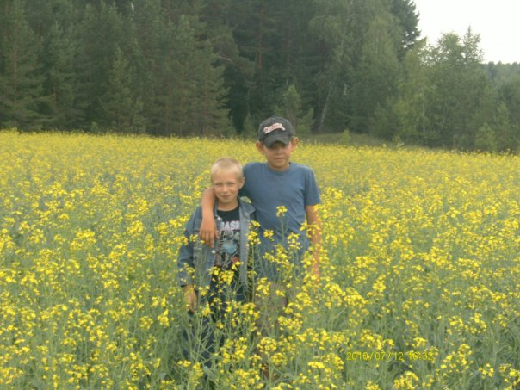
Kurgan Region Kurgan is one of the regional centers of Russia. Kurgan is often called the gate of Siberia. Kurgan region is the youngest in Siberia. It was founded on the sixth of February 1943 when it was separated from Chelyabinsk region. The population of the region is about one million people. More than 100 different peoples live on the territory of Kurgan.92 percent are Russians, among others are Tatars, Bashkirs, Kasakhs, Ukrainians and others. Kurgan region has 23 districts, nine towns and many villages.

Slide 23
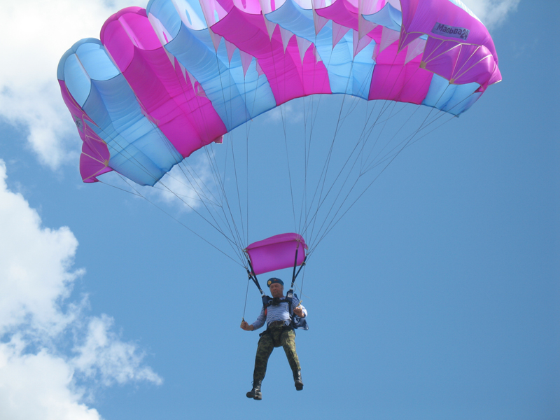
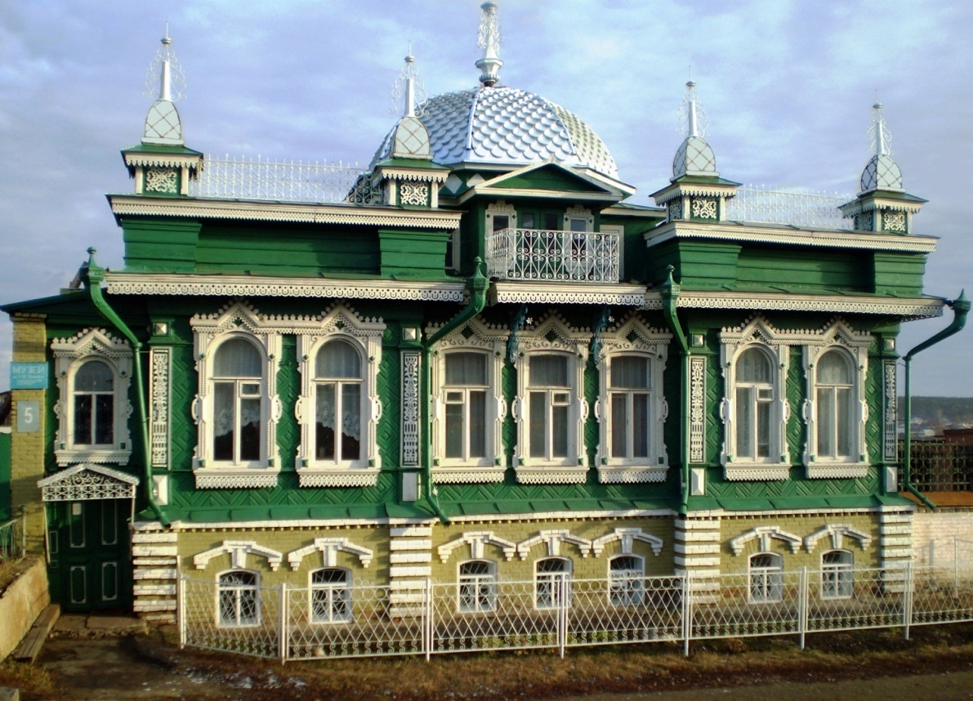
Kurgan region lies in Zauralje. It is traditionally considered an agricultural region. It is rich in clay, lime stone, gypsum and other resources. The main natural wealth of the region is fertile soil. There are many berry and mushroom places and hunting lands on the territory of Kurgan Region. The berries of our forests are wild strawberry, strawberry, cherry, raspberry.

Slide 24
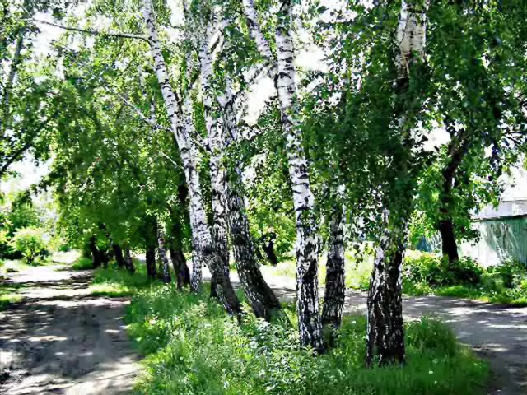
In our forests are there birches, aspens, pines, rowan-trees. The birds of our district are rooks, ravens, sparrows, starlings, blue tits, magpies, bullfinches, cranes, swallows, swans, herons, pigeons and others. The animals living in our region are hares, foxes, wolves, wild boars, elks, squirrels, gophers (ground squirrels) and so on. Many lakes are rich of fish (crucians, pikes, breams). The nature of our region is picturesque.

