Slide 1
School Life
Учитель Молчан Н.В.
МБОУ «ООШ № 17»
Г. Анжеро-Судженск
Кемеровская область

Slide 3
[h] HELLO,HELLO,HELLO TO YOU HELLO,HELLO HOW ARE YOU?

Slide 4
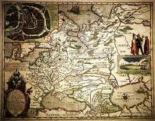
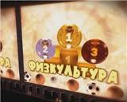

Slide 5
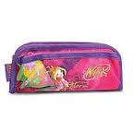

Slide 6
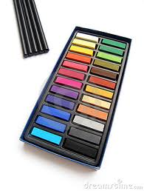
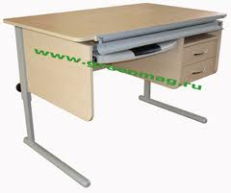

Slide 7
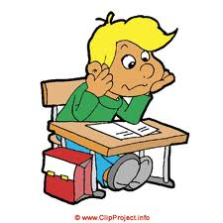

Slide 8
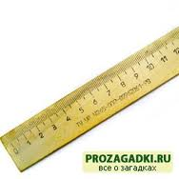
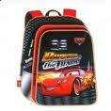
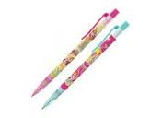

Slide 9
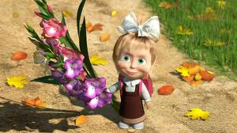
blackboard, plant, desk, teacher’s table, listen, ask questions, learn by heart, translate, retell, write, read, draw, count, copy, sing songs, dictionary, ruler, paints, text book, pencil, rubber, pen, felt-tip pen, bag.

Slide 10
pen; picture; book; cassette recorder; dictionary; computer; rubber; paints. | for translating; for drawing; for writing; for reading; for listening; for playing; for cleaning; for watching.

Slide 11
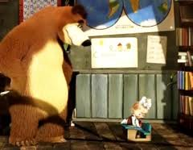
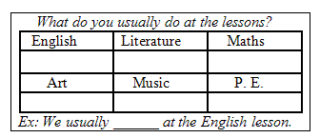
Draw, read, play, translate, count, sing songs

Slide 12
English Schools

Slide 13
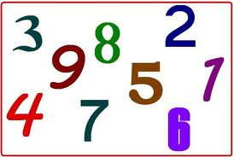

Slide 14
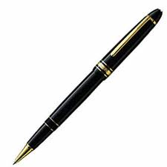
b | f | g | p | k | h | u | a | r | r
k | l | w | e | t | o | p | e | n | u
l | d | a | n | a | p | f | q | t | b
t | e | a | c | h | e | r | a | m | b
w | s | d | i | k | e | t | i | v | e
h | k | u | l | f | b | w | p | h | r
v | t | o | h | s | c | o | p | y | x
d | i | c | t | i | o | n | a | r | y
s | b | l | e | s | s | o | n | r | z
i | q | u | e | s | t | i | o | n | d

Slide 15
THANK YOU

