Slide 1
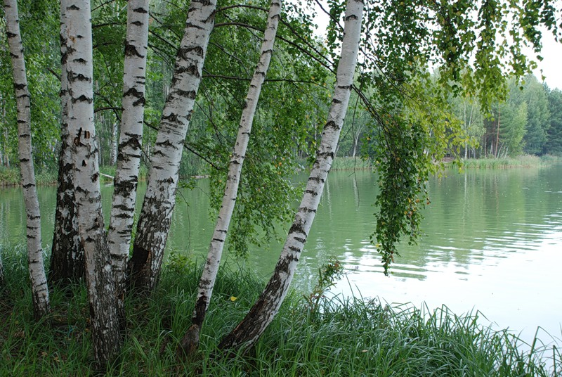
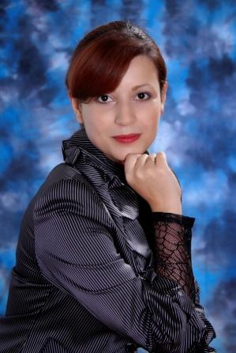
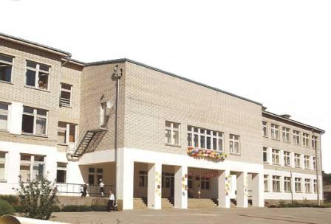
Reznikova
Oxana Vladimirovna
a teacher of English
(school: № 9)

Slide 2
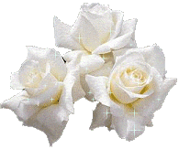
Hello! I am Oxana Vladimirovna.
I am 29 years old.
My date of birth is 27th of November.
I live in Novobataisk, it is not far from Rostov.
Six years ago I finished the Institute in specialty “Foreign Language”.
I have been working as a teacher for eleven years.
I can definitely say that I am a creative, responsible and
sociable woman with a good sense of humor and a great wish to work with
children.
I am a teacher who wants to find an individual way to every pupil.
Notes:
2

Slide 3
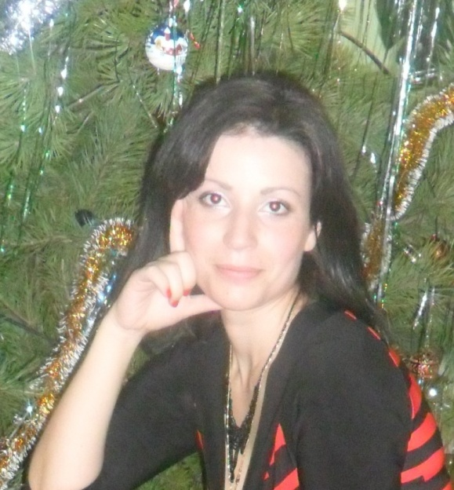
My hobbies
tennis
England
Abba
Poems
A.S. Pushkin

Slide 4
My motto
Start by doing what’s necessary,
then what’s possible, and suddenly
you are doing the impossible.
Francis of Assisi
I agree with Francis of Assisi and think that the profession of a teacher demands a great erudition and patience to children. Of course, it is interesting because you work with different personalities, but it is difficult because you have to teach them a foreign language.
Notes:
4

Slide 5
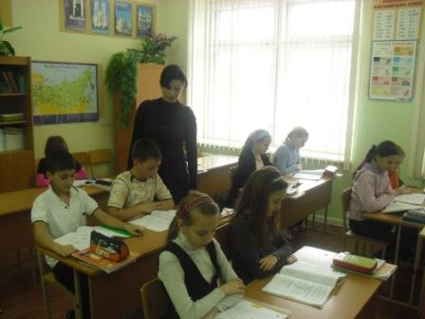
The main goal in my life is to create successful studying for children. Of course I use the modern equipment and methods of teaching but I want to know more.
Being a participant of this course I would like to borrow the pedagogical experience of the foreign colleagues and to improve our school education.
To teach well,
you need to know well.

